Slide 1
PRIM’S/ KRUSKAL
GREEDY ALGORITHM
ALGORITHM ANALYSIS
<<professor>>
Computer Science Department

Slide 2
DEFINITION
A Minimum Spanning Tree (MST) is a subgraph of an undirected graph such that the subgraph spans (includes) all nodes, is connected, is acyclic, and has minimum total edge weight
Computer Science Department

Slide 3
ALGORITHM CHARACTERISTICS
Both Prim’s and Kruskal’s Algorithms work with undirected graphs
Both work with weighted and unweighted graphs but are more interesting when edges are weighted
Both are greedy algorithms that produce optimal solutions
Computer Science Department

Slide 4
PRIM’S ALGORITHM
Similar to Dijkstra’s Algorithm except that d_{v} records edge weights, not path lengths
Computer Science Department

Slide 5
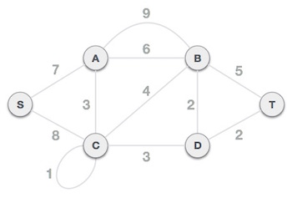
Computer Science Department

Slide 6
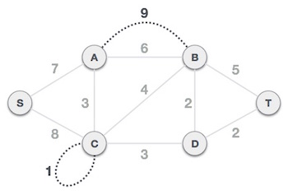
Step 1 - Remove all loops and parallel edges
Computer Science Department

Slide 7
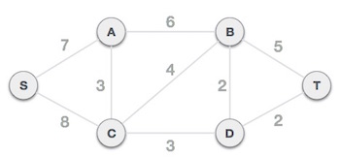
Step 1 - Remove all loops and parallel edges
Computer Science Department

Slide 8
Step 2 - Choose any arbitrary node as root node (S)
Computer Science Department

Slide 9
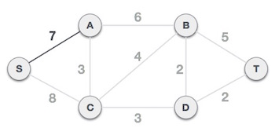
Step 3 - Check outgoing edges and select the one with less cost
We choose the edge S,A as it is lesser than the other.
Computer Science Department

Slide 10
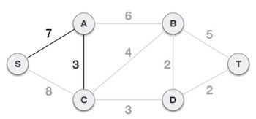
We select the one which has the lowest cost and include it in the tree.
Computer Science Department

Slide 11
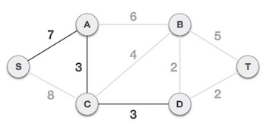
We select the one which has the lowest cost and include it in the tree.
Computer Science Department

Slide 12
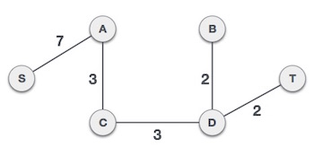
After adding node D to the spanning tree, we now have two edges going out of it having the same cost, i.e. D-2-T and D-2-B. Thus, we can add either one. But the next step will again yield edge 2 as the least cost. Hence, we are showing a spanning tree with both edges included.
Computer Science Department

Slide 13
KRUSKAL’S ALGORITHM
Work with edges, rather than nodes
Two steps:
  Sort edges by increasing edge weight
  Select the first |V| – 1 edges that do not generate a cycle
Computer Science Department

Slide 14
WALK-THROUGH
F
3
C
10
A
Consider an undirected, weight graph
4
3
8
4
6
5
B
D
4
H
4
2
1
3
G
E
3
Computer Science Department

Slide 15
Sort the edges by increasing edge weight
F
3
C
edge | d_{v}
(D,E) | 1
(D,G) | 2
(E,G) | 3
(C,D) | 3
(G,H) | 3
(C,F) | 3
(B,C) | 4
edge | d_{v}
(B,E) | 4
(B,F) | 4
(B,H) | 4
(A,H) | 5
(D,F) | 6
(A,B) | 8
(A,F) | 10
10
A
4
3
8
4
6
5
B
D
4
H
4
2
1
3
G
E
3
Computer Science Department

Slide 16
Select first |V|–1 edges which do not generate a cycle
F
3
C
edge | d_{v}
(D,E) | 1 | 
(D,G) | 2 | 
(E,G) | 3 | 
(C,D) | 3 | 
(G,H) | 3 | 
(C,F) | 3 | 
(B,C) | 4 | 
edge | d_{v}
(B,E) | 4 | 
(B,F) | 4 | 
(B,H) | 4 | 
(A,H) | 5 | 
(D,F) | 6
(A,B) | 8
(A,F) | 10
10
A
4
3
8
4
6
5
B
D
4
H
4
2
1
3
G
E
3
Computer Science Department

Slide 17
Select first |V|–1 edges which do not generate a cycle
F
3
edge | d_{v}
(D,E) | 1 | 
(D,G) | 2 | 
(E,G) | 3 | 
(C,D) | 3 | 
(G,H) | 3 | 
(C,F) | 3 | 
(B,C) | 4 | 
edge | d_{v}
(B,E) | 4 | 
(B,F) | 4 | 
(B,H) | 4 | 
(A,H) | 5 | 
(D,F) | 6
(A,B) | 8
(A,F) | 10
C
A
3
4
5
B
D
H
2
1
3
G
E
}
not
considered
Done
Total Cost =  d_{v} = 21
Computer Science Department

Slide 18

Computer Science Department

